Slide 1
Broadcast Technology UG1
7: Gamma
Jerry Foss
jeremy.foss@bcu.ac.uk

Slide 2
EOTF - Electro-Optical Transfer Function
EOTF
digital code into visible light
Image on a reference display defines the signal
… artist makes creative decisions on what the content will look like while viewing a reference display
grading in post production
camera control units in live production
all reference displays need consistent image reproduction

Slide 3

EOTF - Electro-Optical Transfer Function
EOTF in current standards
SMPTE 292M, SMPTE 372M, HDMI
No EOTF - simply interface specifications
no full details on RGB or YCbCr values
ITU-R Rec. BT.601, 709, 2020
no EOTF - these are encoding specifications
these define the OETF (OptoElectrical Transfer Function)
used for image capture
But image display ≠ inverse of image capture
Bright scene capture environment
… much dimmer display environment
(presentation from Scott Miller, Dolby Laboratories)
https://www.smpte.org/sites/default/files/2014-05-06-EOTF-Miller-1-2-handout.pdf

Slide 4
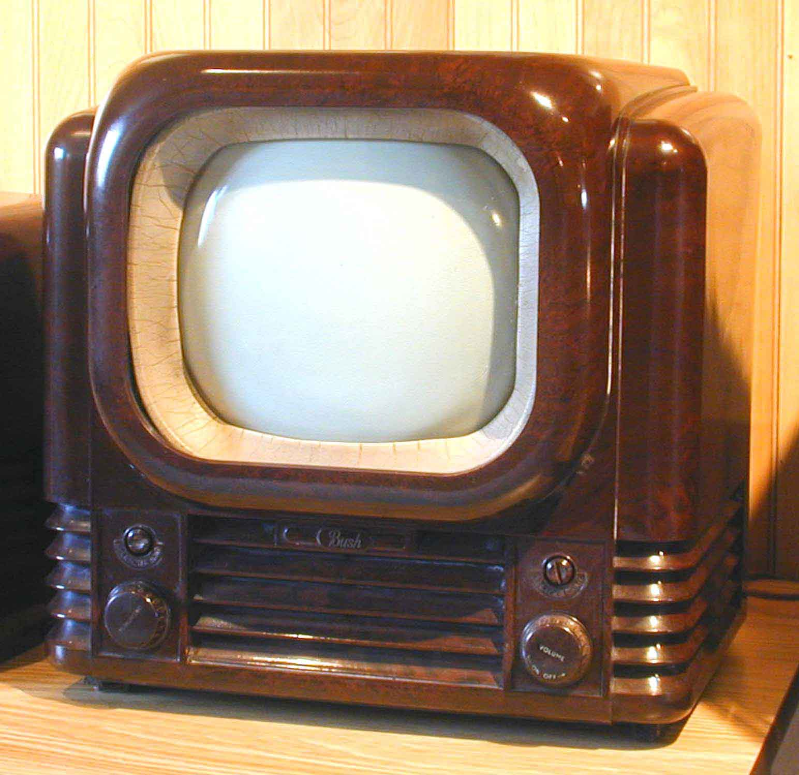
Where is current EOTF defined?
Right here:
Current “Gamma” nonlinearity is based on CRT physics
unchanged since 1930s
Finally standardized by ITU-R Rec. BT.1886 (in 2011!!!)
CRTs almost extinct
the effort was made to officially document their response curve
(presentation from Scott Miller, Dolby Laboratories)
https://www.smpte.org/sites/default/files/2014-05-06-EOTF-Miller-1-2-handout.pdf

Slide 5
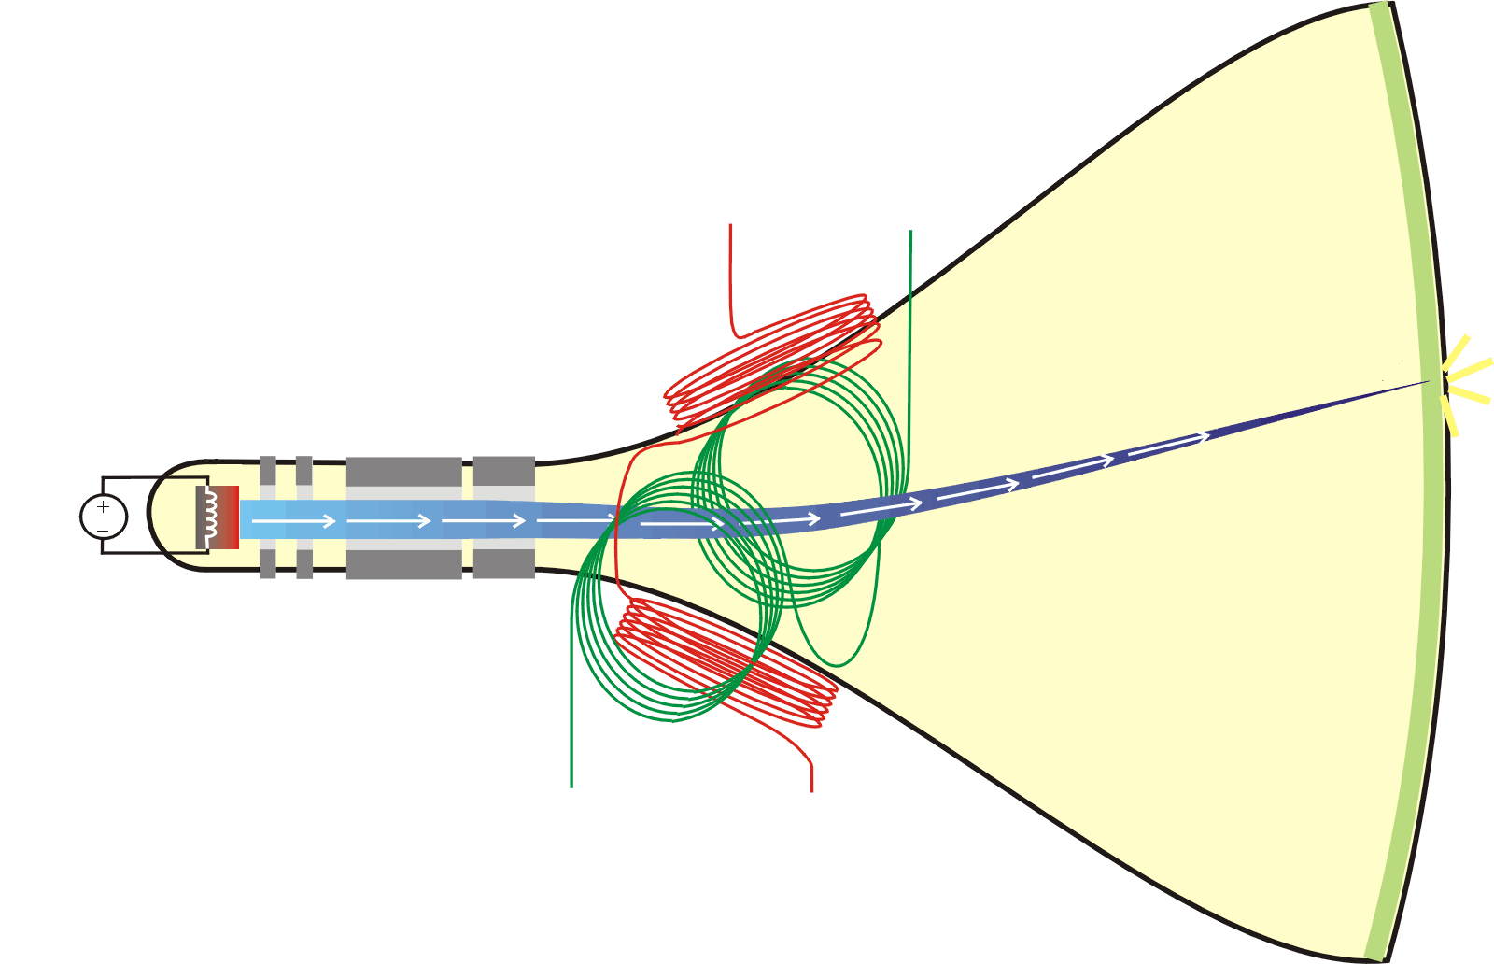
EOTFs and OETFs
OETF functions (as used in Rec.709 etc)
derived from the display EOTF
not the other way around
EOTF was determined by CRT physics
OETF = Inverse EOTF + Rendering Intent
EOTF definition necessary to view finished content properly
EOTF must match the reference display used by the artist to create original program
OETF definition is just a rough target
Camera curves are adjusted for preference during shooting
Textbook Rec709 function is almost never used in practice
EOTF

Slide 6
A New EOTF?
Ideally EOTF should be defined by the human visual response
Current Gamma worked well enough for the CRT era
… is a sort of perceptual EOTF
… But only at relatively low luminance levels
and small dynamic ranges
One proposal for new development:
stretch or modify gamma to allow a little more brightness and dynamic range out the current system
But next generation systems
much brighter
much higher dynamic range
(presentation from Scott Miller, Dolby Laboratories)
https://www.smpte.org/sites/default/files/2014-05-06-EOTF-Miller-1-2-handout.pdf

Slide 7
Power Curves
Binary System Capacity
Gamma

Slide 8
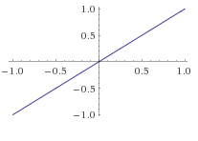
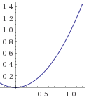
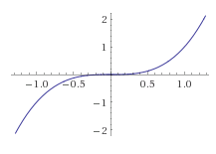
Power-Based Curves

Slide 9
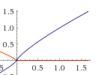

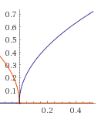
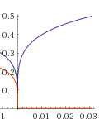
Power-Based Curves

Slide 10
Power-Based Curves
y = x¹
y = x^{(n < 1)}
y
y = x^{(n > 1)}
x

Slide 11
Revision –
Counting in Binary
32 100000
31 11111
30 11110
29 11101
28 11100
27 11011
26 11010
25 11001
24 11000
23 10111
22 10110
21 10101
20 10100
19 10011
18 10010
17 10001
16 10000
15 01111
14 01110
13 01101
12 01100
11 01011
10 01010
9 01001
8 01000
7 00111
6 00110
5 00101
4 00100
3 00011
2 00010
1 00001
0 00000
100000
11111
11110
11101
11100
11011
11010
11001
11000
10111
10110
10101
10100
10011
10010
10001
10000
1111
1110
1101
1100
1011
1010
1001
1000
111
110
101
100
11
10
1
0
doubling in value over previous step
doubling in value over previous step
doubling in value over previous step

Slide 12
Exposure /
illumination intensity
against a binary scale
(binary leading zeros filled in)
… we have more binary levels towards the “bright end” (smaller apertures) …
… but we need more levels at the lower light levels
.. because we perceive illumination differences better at light lower levels
32 100000
31 11111
30 11110
29 11101
28 11100
27 11011
26 11010
25 11001
24 11000
23 10111
22 10110
21 10101
20 10100
19 10011
18 10010
17 10001
16 10000
15 01111
14 01110
13 01101
12 01100
11 01011
10 01010
9 01001
8 01000
7 00111
6 00110
5 00101
4 00100
3 00011
2 00010
1 00001
0 00000
f 11
f 8
f 5.6
f 4
f 2.8
doubling in value over previous step
doubling in value over previous step
doubling in value over previous step

Slide 13

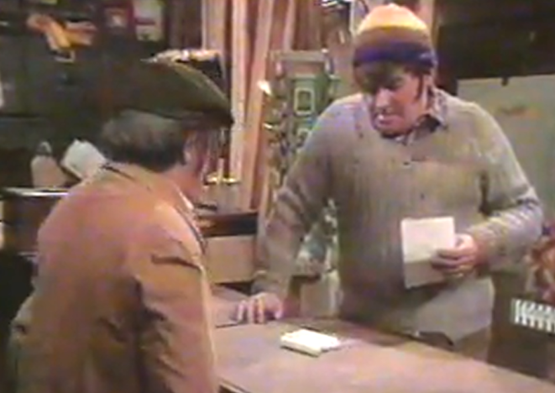
Our Eyes Perceive Brightness Levels
In a Logarithmic Manner
Imagine one lit candle in a dark room
If we light fifteen additional candles, one at a time, the sequence of total candles lit looks like this:
candles - 1 2 3 4 5 6 7 8 9 10 11 12 13 14 15 16
At sixteenth candle - might assume the room would appear to be sixteen times as bright as it did with one candle lit
however, the eye perceives light levels in logarithmic values
room appears just 5x as bright compared to the first candle

Slide 14


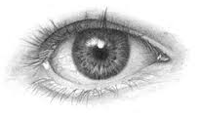
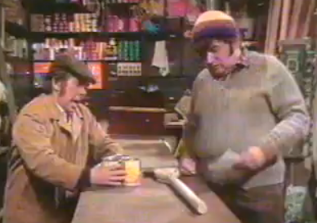
Linear and Logarithmic Gamma
Logarithmic change means
the apparent change in brightness between one candle and two ...
(in our eyes) same as between two candles and four ...
four candles to eight ... same brightness increase
eight to sixteen ... same brightness increase
candles - 1 2 3 4 5 6 7 8 9 10 11 12 13 14 15 16
… the eye sees as …
perceived brightness increase is the same

Slide 15


Linear and Logarithmic Gamma
Looking at it the other way …
In order for the eye to see four equal steps increase of brightness:
1→2 → 3 →4
... we need to light the following numbers of candles:
1→2, 4, 8, 16
The logarithmic steps get bigger as the room appears brighter …
eyes are very good at detecting small steps in dark and mid-tones
but the brightness steps get much bigger when we look at bright objects
… however, camera sensor has linear response
binary coding effectively allocates:
most (smallest) steps to highlights
least (biggest) steps to mid-tones and shadows

Slide 16
Gamma (ɣ)
Aim:
To optimise the use of all the digital codes used in digital imaging
Problem:
The eye perceives light intensity in a logarithmic manner
The digital sensor captures light intensity in linear manner
... and stores these in a range of binary codes from
00000000000000 = 0
00000000000001 = 1
00000000000000 = 2
... etc
...
...
to 11111111111111 = 16,384 ... for a 14 bit sensor
... or 1111111111111111 = 65,536 ... for a 16 bit sensor
Debate: is 16 bit better than 14 bit?
digital noise overwhelms the extra bit depth. Slicing the data more finely than the level of noise means that the extra bit depth doesn't contribute to image quality
http://theory.uchicago.edu/~ejm/pix/20d/tests/noise/noise-p3.html#bitdepth

Slide 17
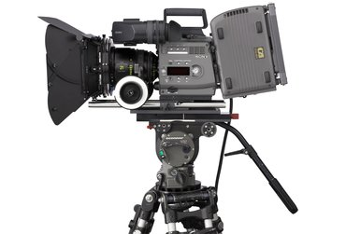
Linear Camera / Logarithmic Eye
11111111111111
11111111111110
11111111111101
11111111111100
16,384
8,192-16,383
4,096-8,191
2,048-4,095
1,024-2,047
512-1,023
256-511
128-255
64-127
32-63
16-31
8-15
4-7
2-6
1-2
“MID GREY”
00000000000100
00000000000011
00000000000001
00000000000000
Dichotomy
Camera – linear recording scene illumination
applies most coding allowance to the light – tone end of the scale …
The Eye – applies most ability to discern tonal variation at the dark – tone end of the scale

Slide 18
Camera / Eye Levels
31 100000
31 11111
30 11110
29 11101
28 11100
27 11011
26 11010
25 11001
24 11000
23 10111
22 10110
21 10101
20 10100
19 10011
18 10010
17 10001
16 10000
15 01111
14 01110
13 01101
12 01100
11 01011
10 01010
9 01001
8 01000
7 00111
6 00110
5 00101
4 00100
3 00011
2 00010
1 00001
0 00000
5 stops up
Exposure stops:
Linear perception of increase in brightness,
as seen by the eye
0 – 31 and so on ...
Linear increase in exposure
.. as seen and recorded by sensor
4 stops up
note – for each successive stop more linear levels are recorded by the sensor (in fact twice as many each stop)
… but the eye doesn’t perceive all the increasing levels
3 stops up
2 stops up
1 stop up
(ref exposure)

Slide 19
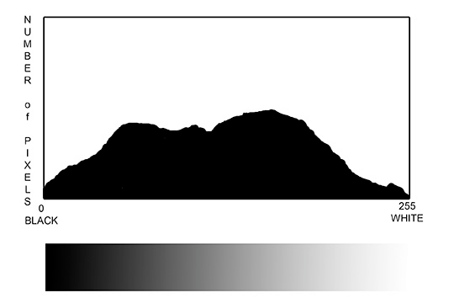
Quantization Levels Aligned to Levels of White - Black
For the number of light levels we have:
11111111111111
11111111111110
11111111111101
11111111111100
16,384 totally saturated sensor (maximum white)
8,192-16,383 1 stop down from maximum white
4,096-8,191 2 stops down from maximum white
2,048-4,095 3 stops down from maximum white
1,024-2,047 4 stops down from maximum white
512-1,023 5 stops down from maximum white
256-511 6 stops down from maximum white
128-255 7 stops down from maximum white
64-127 8 stops down from maximum white
32-63 9 stops down from maximum white
16-31 10 stops down from maximum white
8-15 11 stops down from maximum white
4-7 12 stops down from maximum white
2-6 13 stops down from maximum white
1-2 14 stops down from maximum white
“MID GREY”
14 bit binary counting from 0 to 16,384
00000000000100
00000000000011
00000000000001
00000000000000
note the large number of bits to store the near-white levels
low number of bits for darker levels
note mid-grey at 3 stops down
On a histogram
...upper levels are right-side of the graph ...

Slide 20
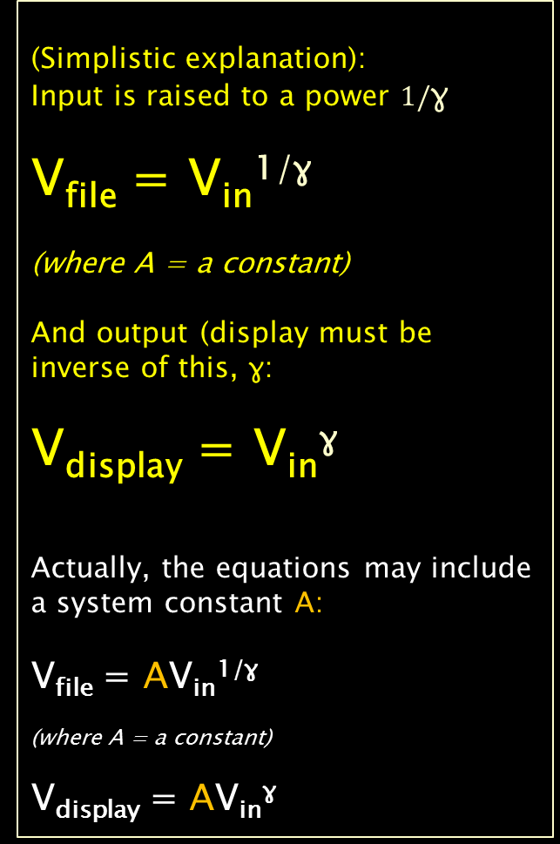
Correction to a Power-Based Curve
(Simplistic explanation):
Input is raised to a power $1/$ɣ
V_{file} = V_{in}^{1/ɣ}
(where A = a constant)
And output (display must be inverse of this, ɣ:
V_{display} = V_{in}^{ɣ}
Actually, the equations may include a system constant A:
V_{file} = AV_{in}^{1/ɣ}
(where A = a constant)
V_{display} = AV_{in}^{ɣ}
Brightness / Intensity of image/Display
Exposure of scene

Slide 21
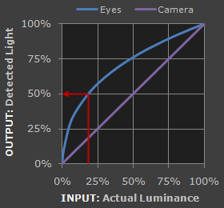
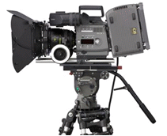



Eye Response Compared to Camera ... Gamma (ɣ)
Camera response is linear ...
Eyes are much more sensitive to changes in dark tones than we are to similar changes in bright tones
this enables our vision to operate over a broader range of luminance
... otherwise - outdoors brightness ranges would be too overwhelming
Camera detects this as 50% as bright
Eyes detect this as 50% as bright
Reference Tone
http://www.cambridgeincolour.com/tutorials/gamma-correction.htm
(full brightness)

Slide 22
Eye Response Compared to Camera ... Gamma (ɣ)
Gamma translates between our eye's light sensitivity and that of the camera
when a digital image is saved, it's gamma encoded
the file more closely corresponds to what we would perceive in brightness increases
Camera detects this as 50% as bright
Eyes detect this as 50% as bright
Reference Tone
(full brightness)
http://www.cambridgeincolour.com/tutorials/gamma-correction.htm

Slide 23
Gamma (ɣ) – the reason
Gamma encoded images store tones more efficiently
redistributes tonal levels closer to how our eyes perceive them
Original:
Encoded using only 32 levels (5 bits)
Linear Encoding:
Gamma Encoding:
... otherwise, more bits required for brighter tones
(where the camera is relatively more sensitive than the eye)
… a shortage of bits for darker tones
(where the camera is relatively less sensitive than the eye)

Slide 24
Gamma (ɣ) – the effect
Linear encoding
insufficient levels to describe the dark tones
excess of levels to describe the bright tones
Normally for images: at least 256 levels (8 bits)
... enough to make tones appear smooth and continuous ...
Original:
Encoded using only 32 levels (5 bits)
Linear Encoding:
Gamma Encoding:
... if linear encoding were used:
8X as many levels (11 bits) would be required to avoid image posterization
Gamma encoded gradient
distributes tones evenly across the full range
- perceptually uniform

Slide 25
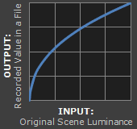
Gamma Encoding
video is recorded with Gamma encoding
low-light regions are encoded to expand the range to match the eye response
Image File Gamma
Depicts an image in the sRGB colour space ... which encodes using a gamma of approx. 1/2.2 ~ 0.45

Slide 26
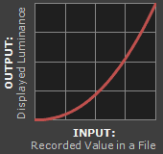
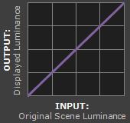
Gamma Workflow – Encoding and Correction
Gamma encoded image needs "gamma correction“ when it is viewed
converts it back into light from the original scene
gamma encoding is for recording the image - not for displaying the image
"display gamma" is automatically performed by monitor / video card
video is recorded with Gamma encoding
Video viewed on a monitor
Net Effect
Video File Gamma
Display Gamma
System Gamma
Depicts an image in the sRGB colour space ... which encodes using a gamma of approx. 1/2.2 ~ 0.45
Depicts a display gamma equal to the standard of 2.2

Slide 27
Image Gamma
Is applied by
camera, or
RAW development software
when a captured image is converted into JPEG or TIFF
redistributes native camera tonal levels into ones which are more perceptually uniform
making the most efficient use of a given bit depth
video is recorded with Gamma encoding
Video File Gamma
Depicts an image in the sRGB colour space ... which encodes using a gamma of approx. 1/2.2 ~ 0.45

Slide 28
Display Gamma
The net influence of the video card and display device
may be comprised of several gammas
purpose - to compensate for a file's (encoded) gamma
ensures that the image isn't unrealistically brightened when displayed on screen
higher display gamma
gives
darker image + greater contrast
Viewed on a Computer Monitor
Display Gamma
Depicts a display gamma equal to the standard of 2.2

Slide 29
System Gamma
The net effect of all gamma values that have been applied to an image
also referred to as the viewing gamma
ideally be close to a straight line (gamma = 1.0)
input (the original scene)
= output (display on your screen)
However - sometimes set >1
improve contrast
can help compensate for limitations due to the dynamic range of a display device
or due to non-ideal viewing conditions and image flare
Net Effect
System Gamma

Slide 30
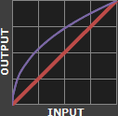
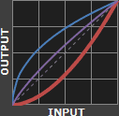
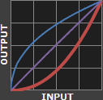
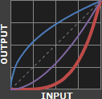




Display Gamma
This is altered when performing monitor calibration
industry has converged on a standard display gamma of 2.2
standard gamma encoded image file
display gamma ... ... ... ...
overall impact on the image
Display Gamma 1.0 1.8 2.2 4.0

Slide 31
Display Gamma
gets brightened substantially because the image gamma is uncorrected by the display gamma
resulting in an overall system gamma that curves upward
display gamma doesn't fully correct for the image file gamma
overall system gamma that still curves upward a little (image still a bit too bright)
Display Gamma 1.0 1.8 2.2 4.0

Slide 32
Display Gamma
display gamma over-compensates for the image gamma
overall system gamma that curves downward
(darkens the image)
display gamma exactly corrects the image gamma
overall linear system gamma
Display Gamma 1.0 1.8 2.2 4.0

Slide 33
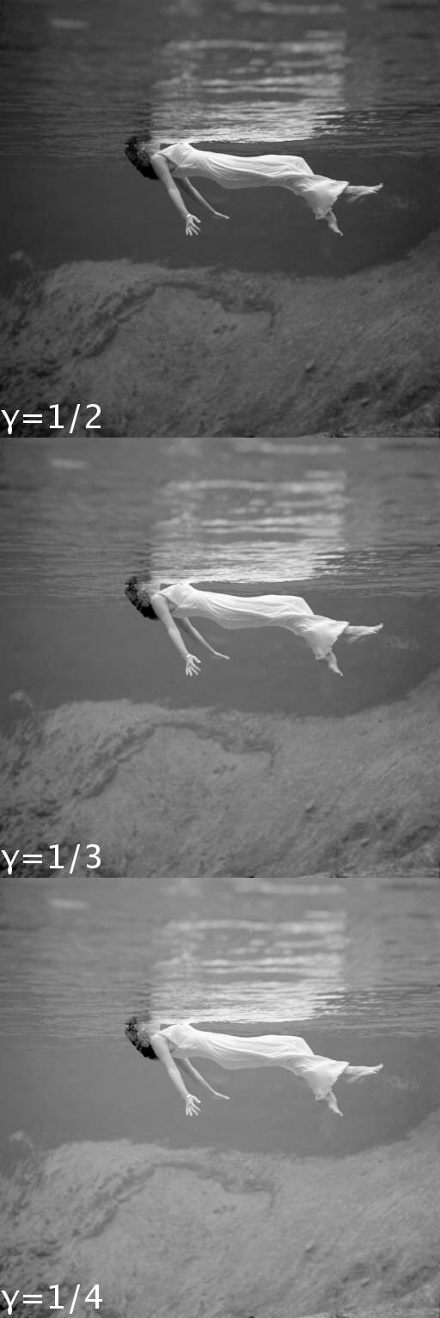
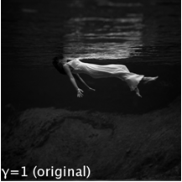
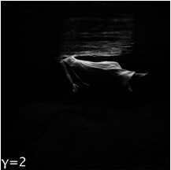
The Effect Of Gamma Correction On An Image
ɣ < 1
Shadows
lighter
The original image
ɣ > 1
Shadows darker

Slide 34
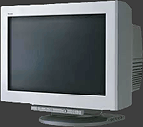
Display Gamma
Display gamma comprises
(i) the native monitor/LCD gamma and
(ii) any gamma corrections applied within the display itself or by the video card
CRT Monitors
engineering coincidence - native gamma = 2.5
almost the inverse of the eye
gamma-encoded file sent straight to the screen and they would automatically be corrected
... appear nearly correct
small gamma correction of ~1/1.1 needed to achieve an overall display gamma of 2.2
usually already set by the manufacturer's default settings
can also be set during monitor calibration

Slide 35

Display Gamma
LCD Monitors
display gamma of 2.2 often requires substantial corrections
devices much less consistent than CRT's
require a look-up table (LUT) to ensure the intended display gamma
Linear gamma (RAW) images
... would still appear as our eyes saw them
... but only if shown on a linear gamma display
- however, this would miss gamma's ability to efficiently record tonal levels

Slide 36
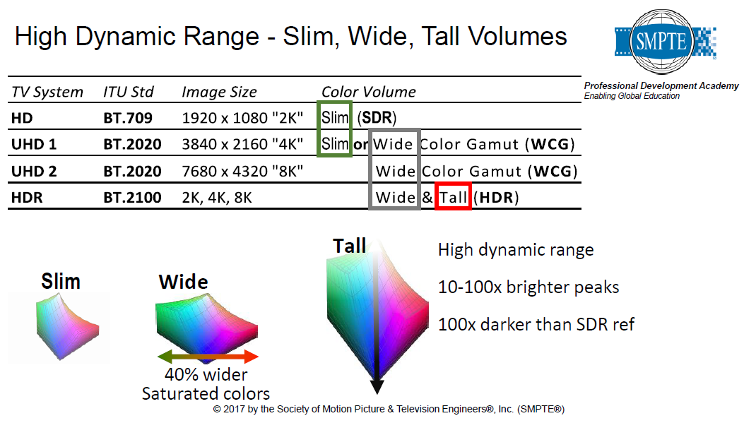

SMPTE ST 2094 and Dynamic Metadata
Not really semantic …
Lars Borg, Principle Scientist, Adobe
SMPTE Standards Webcast series
https://www.smpte.org/sites/default/files/2017-01-12-ST-2094-Borg-V2-Handout.pdf

Slide 37
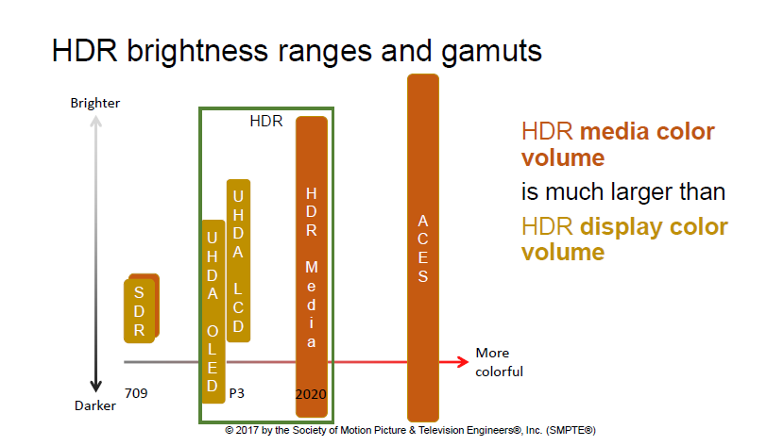
SMPTE ST 2094 and Dynamic Metadata

Slide 38
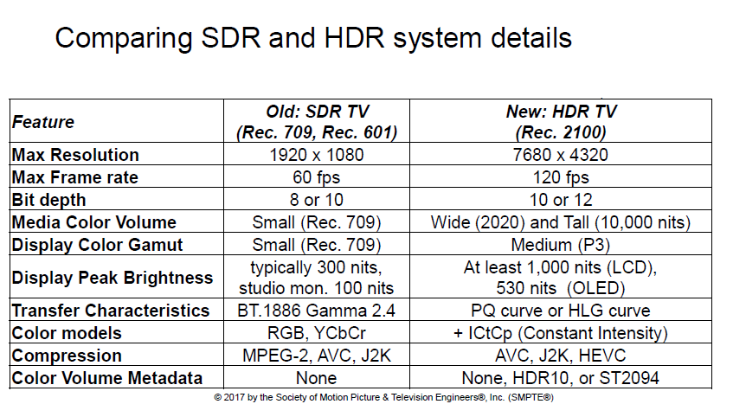
SMPTE ST 2094 and Dynamic Metadata

Slide 39
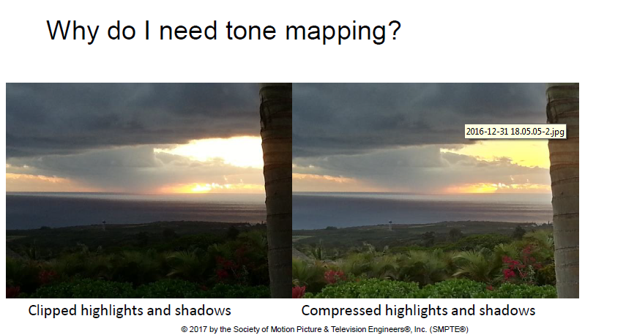
SMPTE ST 2094 and Dynamic Metadata

Slide 40
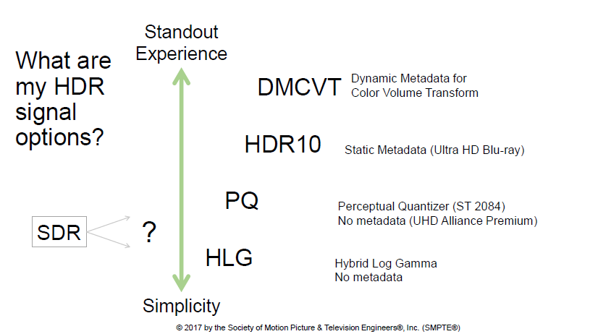
SMPTE ST 2094 and Dynamic Metadata

Slide 41
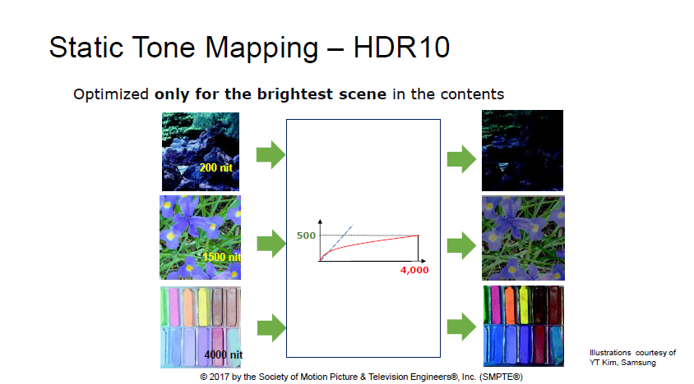
SMPTE ST 2094 and Dynamic Metadata

Slide 42
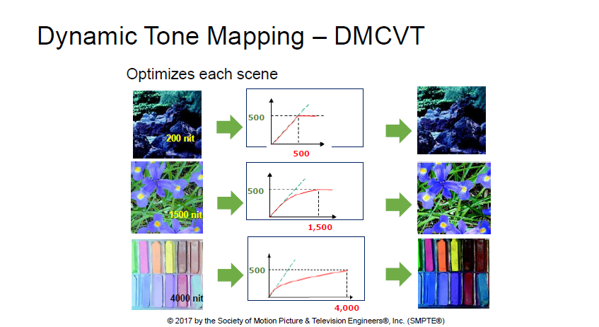
SMPTE ST 2094 and Dynamic Metadata

Slide 43
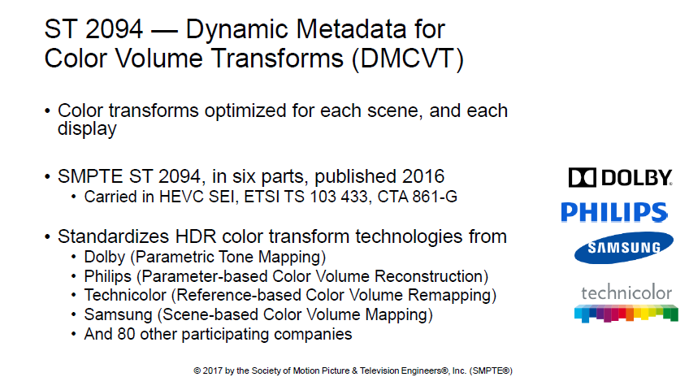
SMPTE ST 2094 and Dynamic Metadata

Slide 44
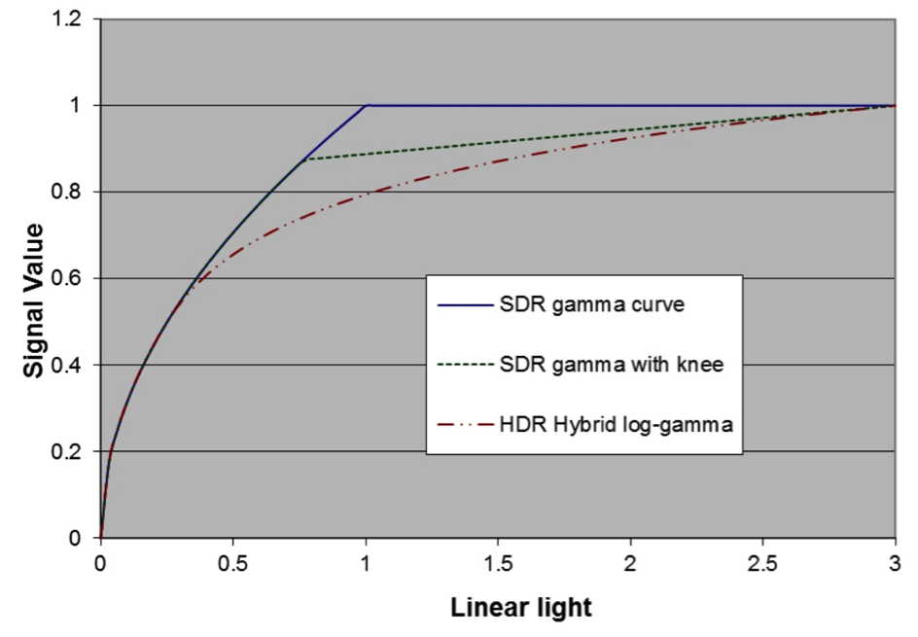
Hybrid Log Gamma OETF
Single signal - SDR to legacy TV; HDR to new displays
uses a logarithmic curve in the highlights (since the quantisation noise is almost constant)
and a gamma curve in the dark areas since the visibility threshold for quantisation is higher
gamma curve in HLG (for a large part of the signal range) = backward compatibility with legacy displays
The State of HDR in Broadcast and OTT – CES 2016 update
http://www.ctoic.net/blog/the-state-of-hdr-in-broadcast-and-ott-at-year-end-2015/

Slide 45
Hybrid Log Gamma OETF
HLG specifies a scene-referred HDR signal
every pixel in the image represents the light intensity in the captured scene
transfer characteristics specified by HLG can be implemented directly in the camera
signal produced by the camera is independent of the display
no additional processing, no metadata

Slide 46
